Slide 1

Predicting Prices for Airbnb Accommodations
Capstone Project

Slide 2







Problem Statement

Slide 3
Data Analysis Process
Cleaning Data
EDA
Model

Slide 4

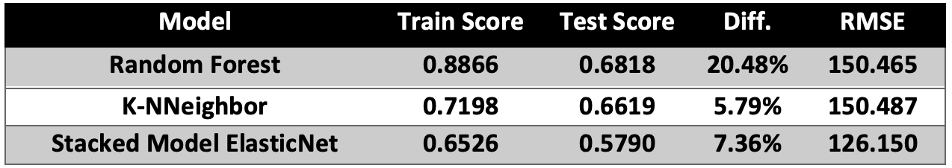


Machine Learning Models

Slide 5
Evaluation

Slide 6
Conclusions and Recommendations

Slide 7
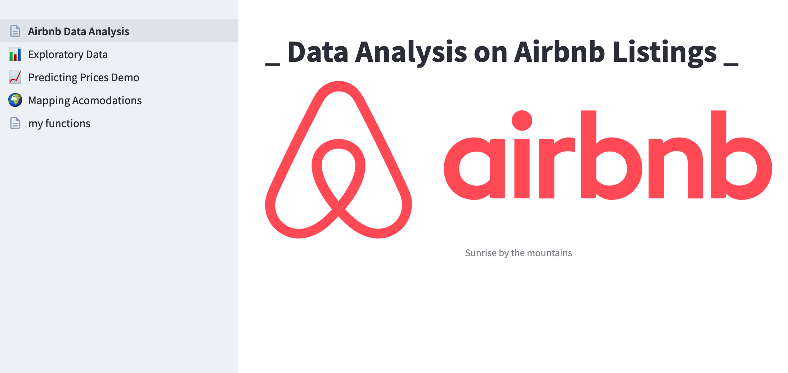
Airbnb App
App to explorer Airbnb Listing Data and Predicting Prices:
Airbnb Explorer App

Slide 8
Thank You!

